Slide 1

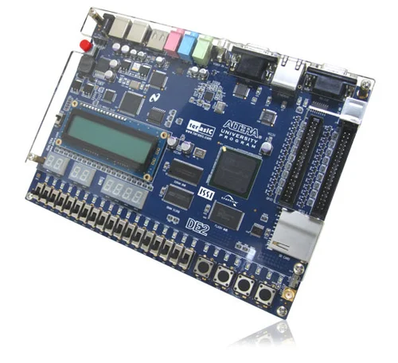
VIETNAM NATIONAL UNIVERSITY — HO CHI MINH CITY
INTERNATIONAL UNIVERSITY
IMPLEMENTATION OF MACHINE LEARNING FOR
MNIST DIGITS RECOGNITION ON FPGA
NGUYEN MINH DUC - ITITIU21045
Advisor: Assoc. Prof. DINH DUC ANH VU
Mentor: M. Sc. VO MINH THANH
School of Computer Science and Engineering
2025
01

Slide 2

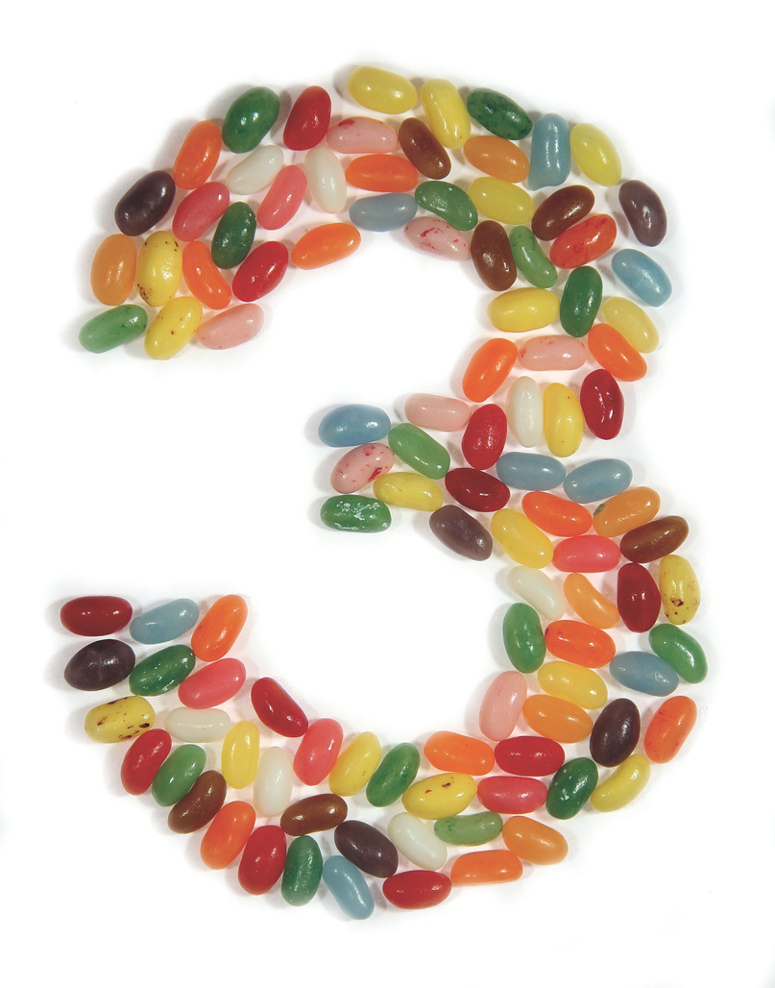









CONTENTS
01
Problem Statement
02
Workflow
03
Methodology
04
Result & Demo
05
Conclusion
02

Slide 3

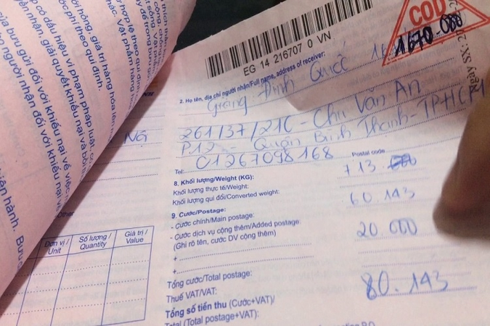
PROBLEM STATEMENT
Background and Context
Handwritten digit recognition plays a critical role in various real-world applications (marking points, postal code reading, bank check processing, etc.).
Field-programmable gate arrays (FPGAs) have become a pivotal hardware platform for speeding up machine-learning workloads.
Implementing efficient MNIST recognition models on FPGA still deals with challenges in terms of resource utilization, latency, memory space, and accuracy.
03

Slide 4
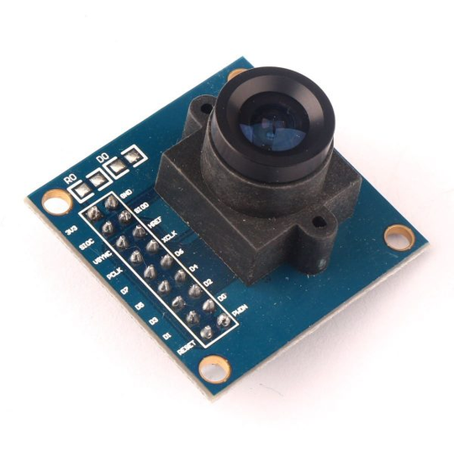
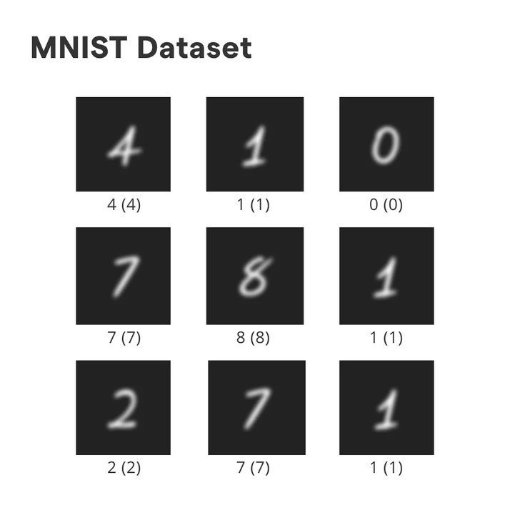
PROBLEM STATEMENT
Challenge Overview
Achieve real-time (> 200 fps)
High-accuracy (≥ 98 %)
Standalone FPGA while staying within the device’s on-chip memory, power, and latency budgets
No resorting to an external CPU or GPU
04

Slide 5





OBJECTIVE
Achieve robust model accuracy
Design & verify every layer in hardware
Validate the complete inference pipeline
Synthesize and implement on the FPGA
05

Slide 6
WORKFLOW
Select
CNN model
Create custom CNN model
Train
custom model
Extract
weights and biases
Design each layer in Verilog
Validate each layer
Simulate full layer CNN model in ModelSim
Synthesize on Quartus
Deploy on board
06

Slide 7
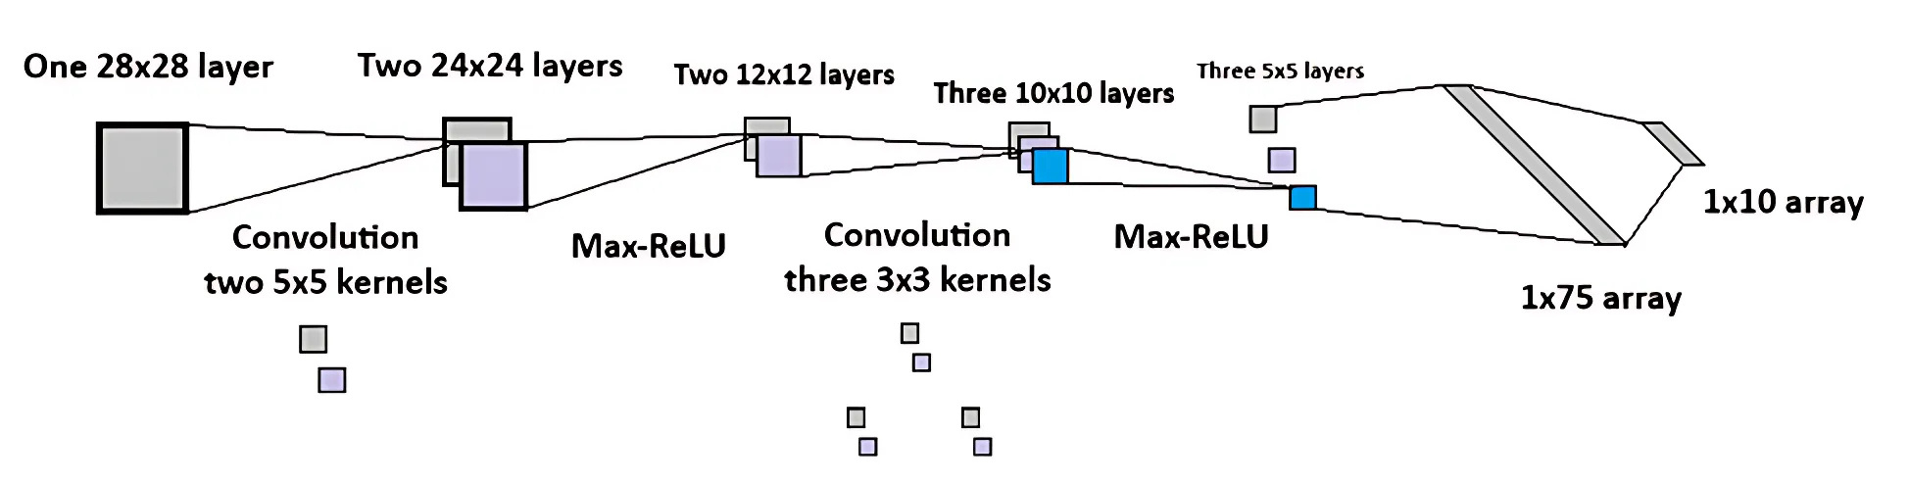
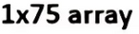
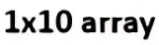
METHODOLOGY
01
Logical Structure
Two main layer levels, each level including a convolutional layer and a Max-ReLU activation layer.
Three 5x5 layers after two convolutional levels are flattened into a 1x75 array.
Fully connected layer to transform into 1x10 array and the argmax function is applied to get the digit.
ArgMax
Fully Connected
07

Slide 8
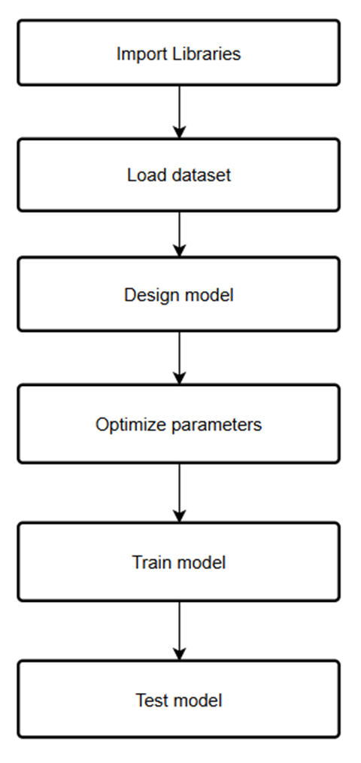
METHODOLOGY
02
Training CNN Model
Import the PyTorch library.
Load the MNIST dataset to get training and testing data.
Design the architecture based on the logical structure.
Optimize the parameters before training.
Train the model to achieve the weights and biases of each layer.
Test the model with examples to validate the accuracy.
Save the weights and biases under .txt file for hex file conversion.
08

Slide 9
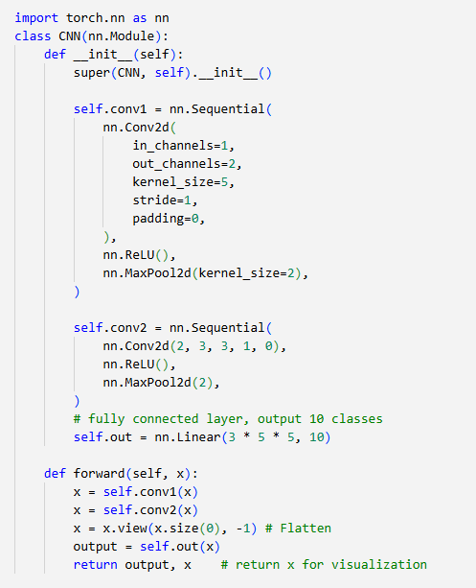
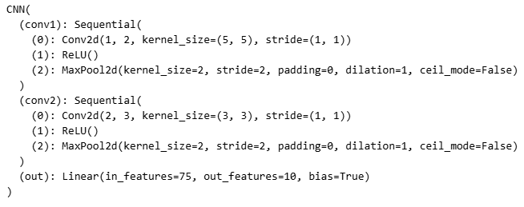
METHODOLOGY
02
Training CNN Model
09

Slide 10
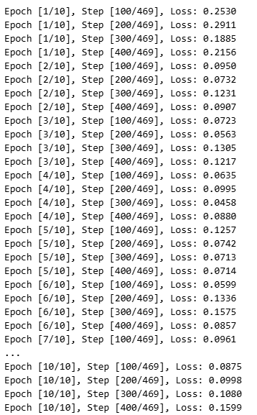
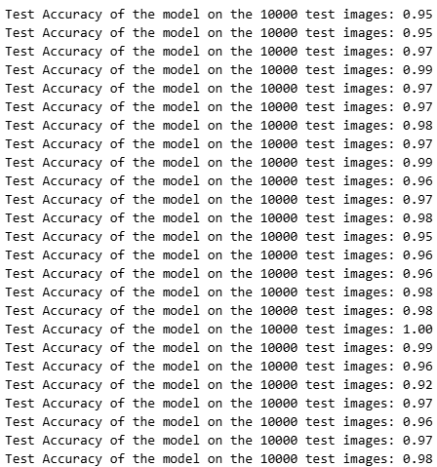
METHODOLOGY
02
Training CNN Model
Accuracy after training (>90%)
10 epochs, 469 steps each
10

Slide 11


METHODOLOGY
03
Image Conversion
Write the digit by using Paint for the raw image in PNG format.
Convert the raw image into grayscale array format.
Flatten the array to one dimension.
Normalize the data to the -1.0 to 1.0 range.
Convert the data to signed float fixed point using quantise (Q2.13 for 16 bits and Q15.16 for 32 bits).
Save the result under .hex or .mif file format.
Q2.13 | Sign bit | 2-bit integer part | 2-bit integer part | 13-bit fraction part | 13-bit fraction part | 13-bit fraction part | 13-bit fraction part | 13-bit fraction part | 13-bit fraction part | 13-bit fraction part | 13-bit fraction part | 13-bit fraction part | 13-bit fraction part | 13-bit fraction part | 13-bit fraction part | 13-bit fraction part
Bit Value | -22 | 21 | 20 | 2-1 | 2-2 | 2-3 | 2-4 | 2-5 | 2-6 | 2-7 | 2-8 | 2-9 | 2-10 | 2-11 | 2-12 | 2-13
11

Slide 12
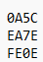
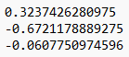
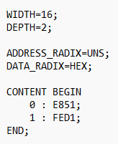
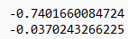
METHODOLOGY
04
Weights and Biases Conversion
Extract the weights and biases of convolutional and fully connected layers under .txt file.
Convert all the .txt weights and biases to .hex format for simulation on ModelSim or .mif format for synthesis on Quartus II 9.0.
The weights and biases are loaded only once since they are fixed.
.txt to .hex format
.txt to .mif format
12

Slide 13
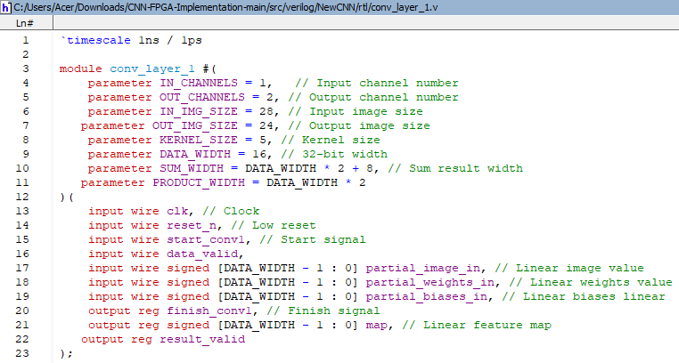
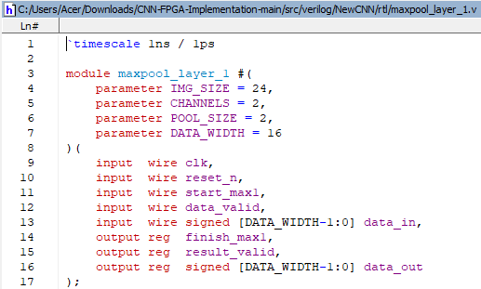
METHODOLOGY
05
Design each layer
First convolutional layer
First max pooling layer
13

Slide 14
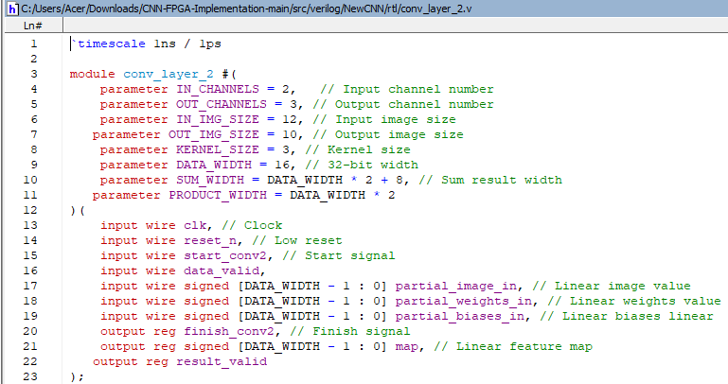

METHODOLOGY
05
Design each layer
Second convolutional layer
Second max pooling layer
14

Slide 15
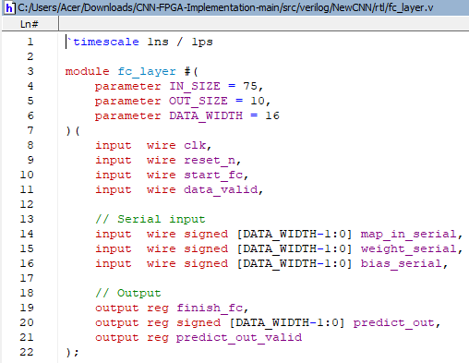
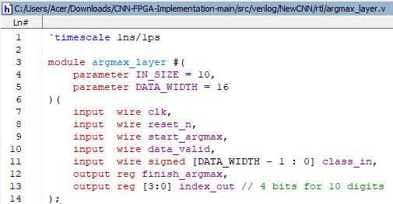
METHODOLOGY
05
Design each layer
Fully connected layer
ArgMax layer
15

Slide 16
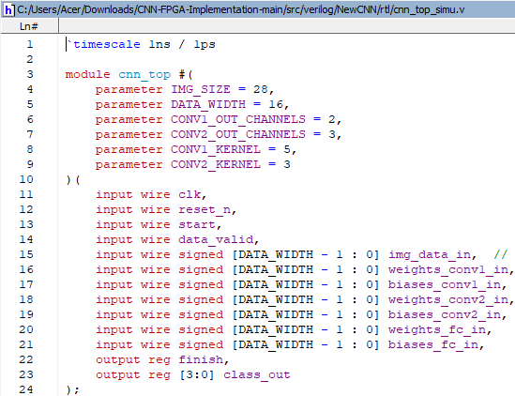
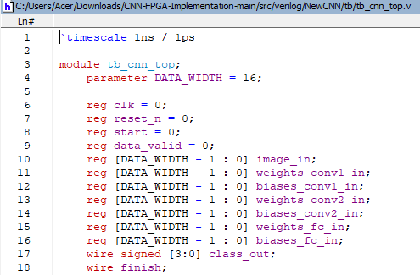
METHODOLOGY
05
Design each layer
Top module
Testbench module
16

Slide 17
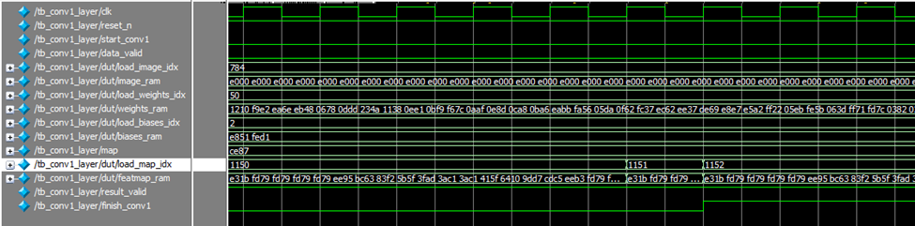
RESULT
01
First Convolutional Layer
First Convolutional Layer Waveform
17

Slide 18
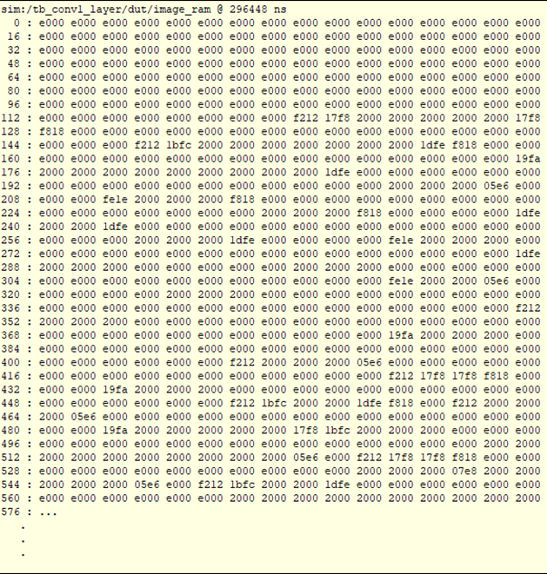
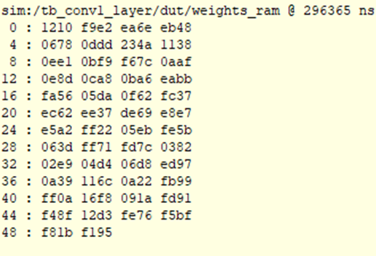
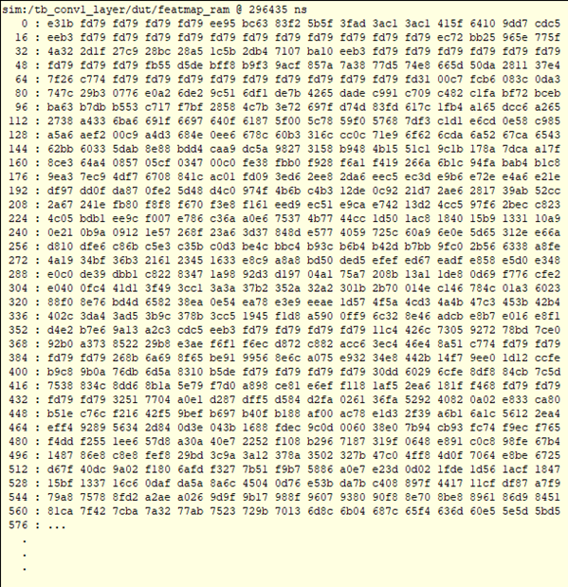
RESULT
01
First Convolutional Layer
Weights CV1 RAM
Biases CV1 RAM
Image CV1 RAM
Map Output CV1 RAM
18

Slide 19
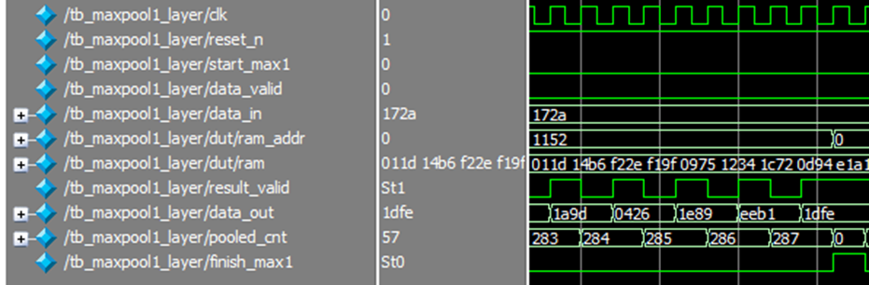
RESULT
02
First Max Pooling Layer
First Max Pooling Layer Waveform
19

Slide 20
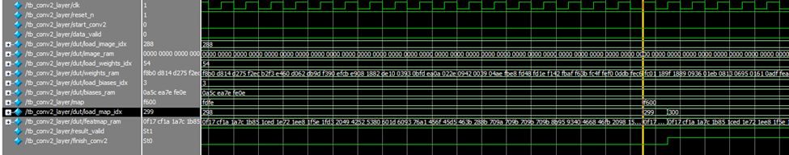
RESULT
03
Second Convolutional Layer
Second Convolutional Layer Waveform
20

Slide 21
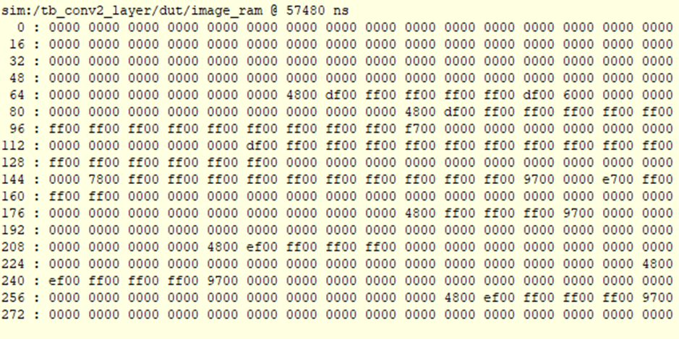
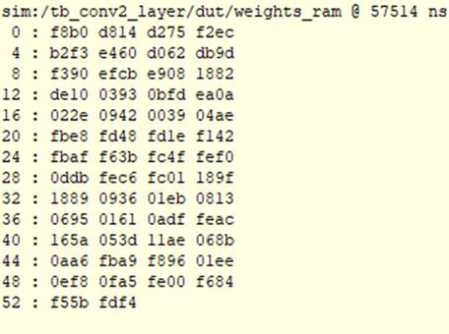
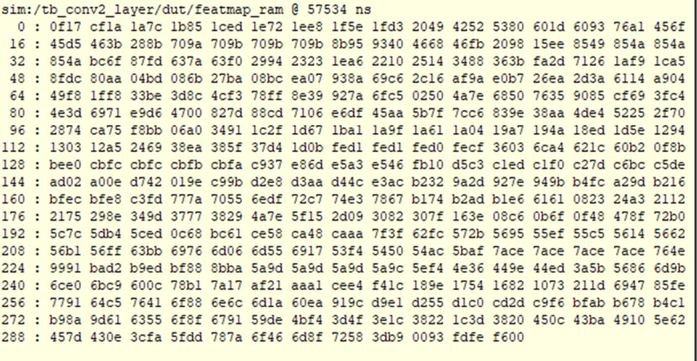
RESULT
03
Second Convolutional Layer
Weights CV2 RAM
Image CV2 RAM
Biases CV2 RAM
Map Output CV2 RAM
21

Slide 22
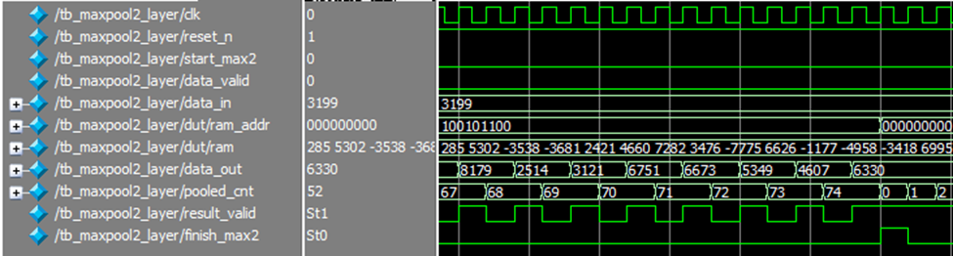
RESULT
04
Second Max Pooling Layer
Second Max Pooling Layer Waveform
22

Slide 23
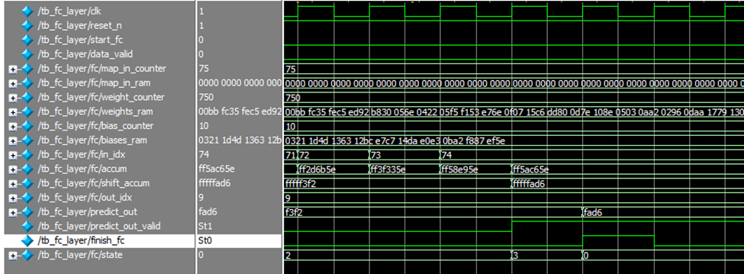
RESULT
05
Fully Connected Layer
Fully Connected Layer Waveform
23

Slide 24
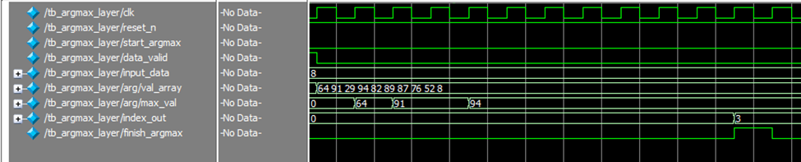
RESULT
06
ArgMax Layer
ArgMax Layer Waveform
24

Slide 25
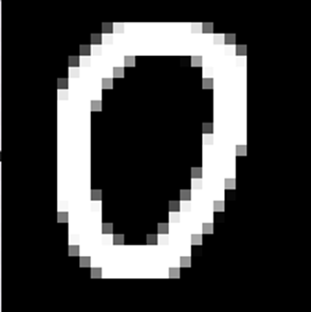
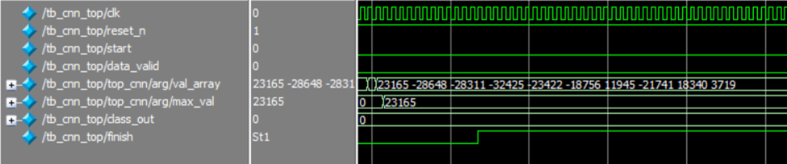

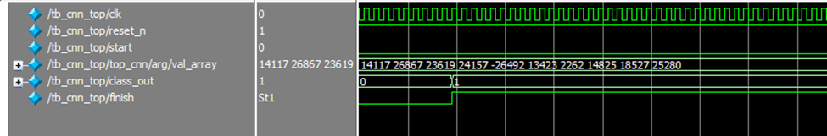
RESULT
07
Top Module
25

Slide 26
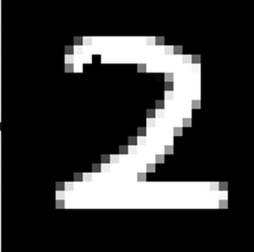
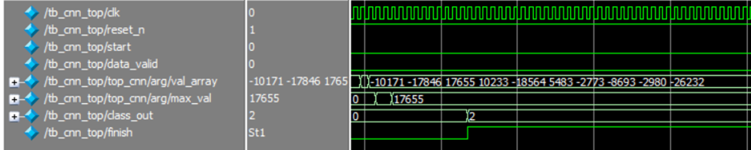
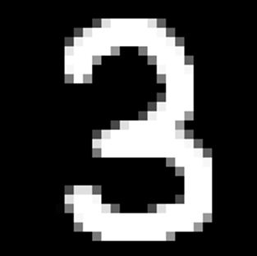
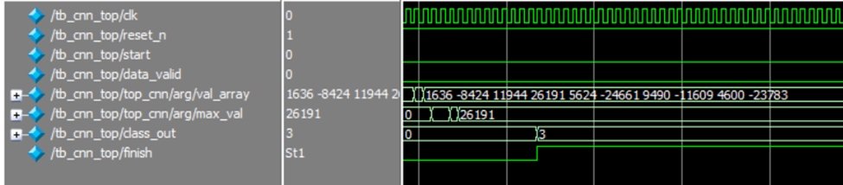
RESULT
07
Top Module
26

Slide 27
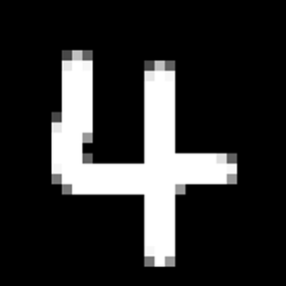
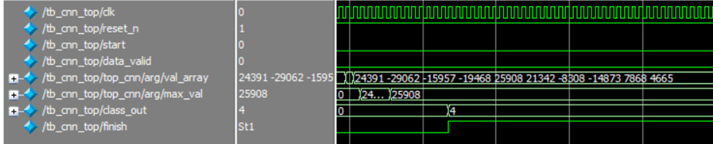

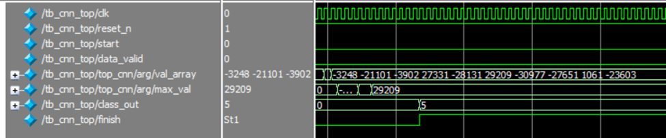
RESULT
07
Top Module
27

Slide 28

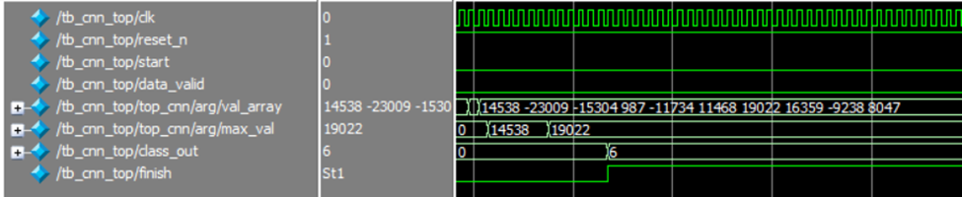

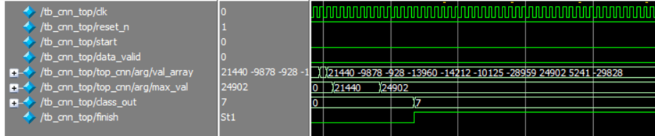
RESULT
07
Top Module
28

Slide 29

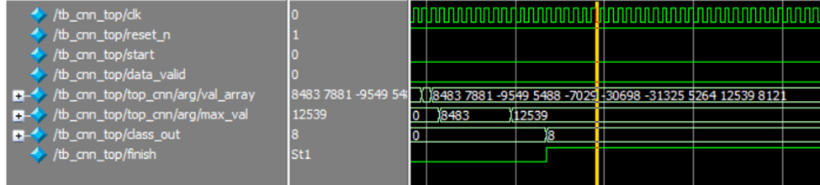

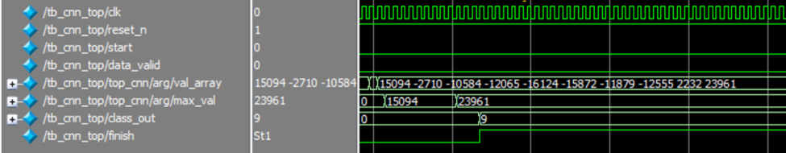
RESULT
07
Top Module
29

Slide 30

RESULT
08
FPGA
Load Image First Convolutional Layer
29

Slide 31
Demo
31

Slide 32
Conclusion
Success
Limitation
Train and extract the weights and biases of the model.
Design and verify the neural network.
Lack of memory when implement onto FPGA.
No real-time input due to lack of time.
Future work
Apply acceleration to speed up the execution time.
Implement real-time peripherals by using camera, sensors, etc.
07

Slide 33
Thank You For Listening
10

